Slide 1
Module 10: Decoupling

Slide 2














Decoupling, the basic idea
A
B
AB
$$X_{a}^{(A)}$$
$$X_{c}^{(A)}$$
$$X_{c}^{(B)}$$
$$X_{b}^{(B)}$$
$$X_{a}^{(AB)}$$
$$X_{c}^{(AB)}$$
$$X_{b}^{(AB)}$$
Coupling
$$X_{a}^{(AB)}$$
$$X_{c}^{(AB)}$$
$$X_{b}^{(AB)}$$
$$X_{a}^{(A)}$$
$$X_{c}^{(A)}$$
$$X_{c}^{(B)}$$
$$X_{b}^{(B)}$$
Decoupling
AB
A
B

Slide 3
Some objectives of decoupling
Find the FRFs or eigen modes of components that can not be well measured when standalone (e.g. removing dynamics of test-frame).
Obtain the FRFs or eigenmodes of a component including its interface dynamics (damping and stiffness).
To get an estimate of the result of an exchange from one component to another. Then decoupling and decoupling are made consecutively or simultaneously.

Slide 4
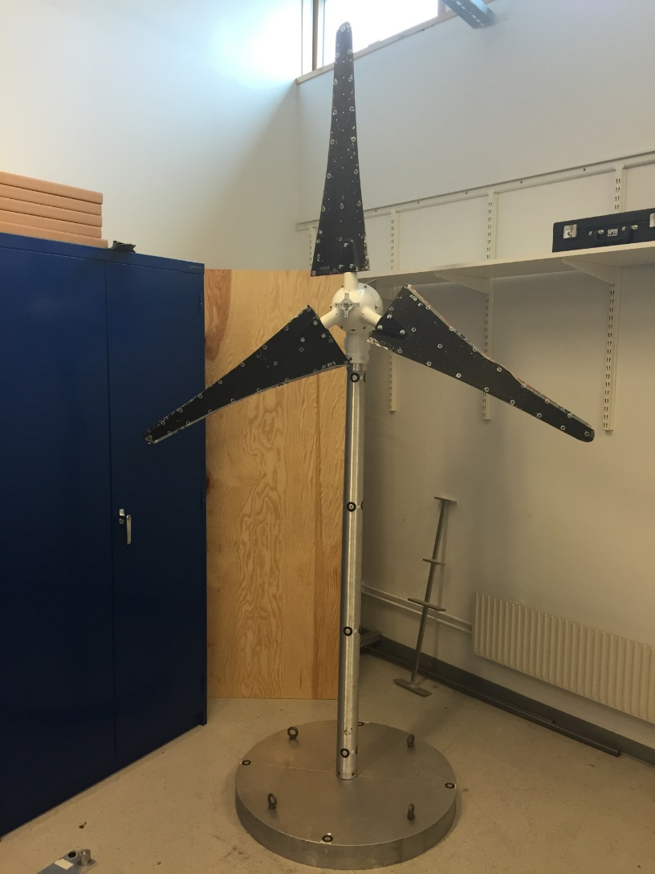
A substructuring benchmark structure
An Ampair A600 wind turbine

Slide 5

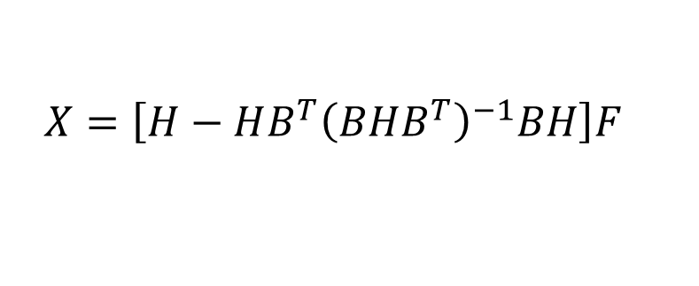

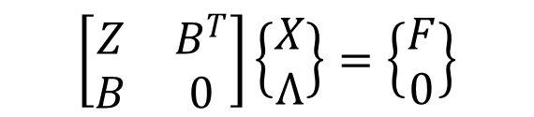
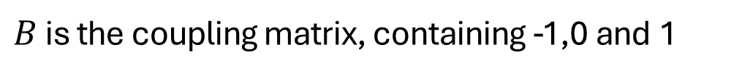

Reminder of frequency based substructuring (FBS)
The dual assembly in the frequency domain can be written as:
$$\left[\begin{matrix}Z & B^{T} \\ B & 0\end{matrix}\right]\left\{\begin{matrix}X \\ Λ\end{matrix}\right\}=\left\{\begin{matrix}F \\ 0\end{matrix}\right\}$$
in which
$$Z=\left[−Ω^{2}M+iΩC+K\right]$$
is the dynamic stiffness
$B$ is the coupling matrix, containing -1,0 and 1
$Λ$ is the vector containg the interface forces. With $H=Z^{−1}$
the displacement vector, containing all the dofs, can be solved for
$$HG$$
$$X=\left[\left.H−HB^{T}{\left(BHB^{T}\right)}^{−1}BH\right]F\right.$$
$$Λ$$
From which the FRFs of the coupled system can be calculated

Slide 6
Frequency based decoupling
Subtracting a substructure is equivalent to adding a negative version of that substructure.
AB
A
B
AB
-A
B

Slide 7
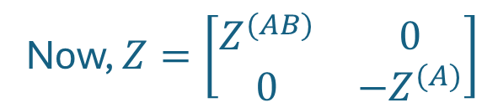
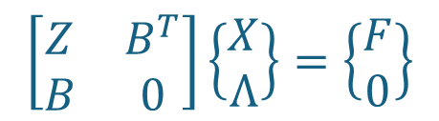
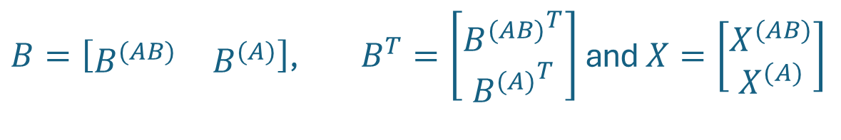
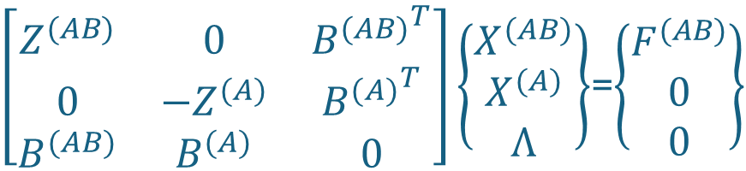
Frequency based decoupling
Let’s imagine that we add a negative substructure. Then we can use the same formulas. Hence:
Hence:
$$\left[\begin{matrix}Z & B^{T} \\ B & 0\end{matrix}\right]\left\{\begin{matrix}X \\ Λ\end{matrix}\right\}=\left\{\begin{matrix}F \\ 0\end{matrix}\right\}$$
Now, $Z=\left[\begin{matrix}Z^{(AB)} & 0 \\ 0 & {−Z}^{(A)}\end{matrix}\right]$
$B=\left[\begin{matrix}B^{(AB)} & B^{(A)}\end{matrix}\right]$, $B^{T}=\left[\begin{matrix}{B^{(AB)}}^{T} \\ {B^{(A)}}^{T}\end{matrix}\right]$ and $X=\left[\begin{matrix}X^{(AB)} \\ X^{(A)}\end{matrix}\right]$
$\left[\begin{matrix}Z^{(AB)} & 0 & {B^{(AB)}}^{T} \\ 0 & {−Z}^{(A)} & {B^{(A)}}^{T} \\ B^{(AB)} & B^{(A)} & 0\end{matrix}\right]\left\{\begin{matrix}X^{(AB)} \\ X^{(A)} \\ Λ\end{matrix}\right\}$=$\left\{\begin{matrix}F^{(AB)} \\ 0 \\ 0\end{matrix}\right\}$

Slide 8
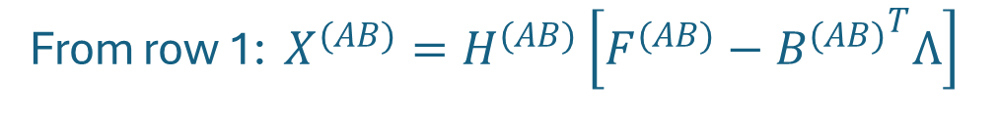


Frequency based decoupling
$\left[\begin{matrix}Z^{(AB)} & 0 & {B^{(AB)}}^{T} \\ 0 & {−Z}^{(A)} & {B^{(A)}}^{T} \\ B^{(AB)} & B^{(A)} & 0\end{matrix}\right]\left\{\begin{matrix}X^{(AB)} \\ X^{(A)} \\ Λ\end{matrix}\right\}$=$\left\{\begin{matrix}F^{(AB)} \\ 0 \\ 0\end{matrix}\right\}$
From row 1: $X^{(AB)}=H^{(AB)}\left[F^{(AB)}−{B^{(AB)}}^{T}Λ\right]$
From row 2: $X^{(A)}=H^{(A)}\left[{B^{(A)}}^{T}Λ\right]$
Then row 3: $B^{(AB)}H^{(AB)}\left[F^{(AB)}−{B^{(AB)}}^{T}Λ\right]+B^{(A)}H^{(A)}\left[{B^{(A)}}^{T}Λ\right]=0$
So; $Λ={\left[B^{(AB)}H^{(AB)}{B^{(AB)}}^{T}−B^{(A)}H^{(A)}{B^{(A)}}^{T}\right]}^{−1}$ $B^{(AB)}H^{(AB)}$ $F^{(AB)}$ and then;
$$X^{(AB)}=\left[H^{(AB)}−{{H^{(AB)}B}^{(AB)}}^{T}{\left[B^{(AB)}H^{(AB)}{B^{(AB)}}^{T}−B^{(A)}H^{(A)}{B^{(A)}}^{T}\right]}^{−1} B^{(AB)}H^{(AB)}\right]F^{(AB)}$$
$$X^{(A)}=\left[H^{(A)}{B^{(A)}}^{T}{\left[B^{(AB)}H^{(AB)}{B^{(AB)}}^{T}−B^{(A)}H^{(A)}{B^{(A)}}^{T}\right]}^{−1} B^{(AB)}H^{(AB)}\right]F^{(AB)}$$
$X^{(A)}$ is also a part of $X^{(AB)}$. Hence, some dofs occur in more than one position.

Slide 9


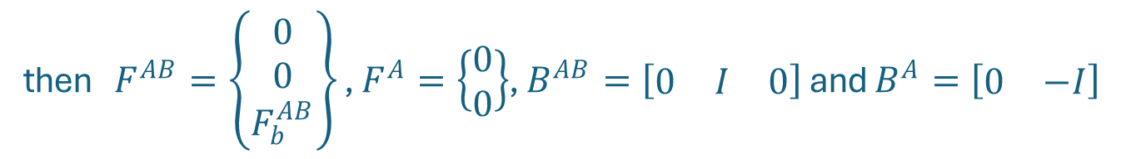





Frequency based decoupling
$$X_{a}^{(AB)}$$
$$X_{c}^{(AB)}$$
$$X_{b}^{(AB)}$$
$$X_{a}^{(A)}$$
$$X_{c}^{(A)}$$
$$X_{c}^{(B)}$$
$$X_{b}^{(B)}$$
AB
-A
B
Let us partition the structures $AB$ and $the negative A$ such that:
$X^{AB}=\left\{\begin{matrix}X_{a}^{AB} \\ X_{c}^{AB} \\ X_{b}^{AB}\end{matrix}\right\}$,
then $F^{AB}=\left\{\begin{matrix}0 \\ 0 \\ F_{b}^{AB}\end{matrix}\right\}$ , $F^{A}=\left\{\begin{matrix}0 \\ 0\end{matrix}\right\}$, $B^{AB}=\left[\begin{matrix}0 & I & 0\end{matrix}\right]$ and $B^{A}=\left[\begin{matrix}0 & −I\end{matrix}\right]$
$$X^{A}=\left\{\begin{matrix}X_{a}^{A} \\ X_{c}^{A}\end{matrix}\right\}$$
This results in the frequency response matrices:
$$H^{AB}=\left[\begin{matrix}H_{aa}^{AB} & H_{ac}^{AB} & H_{ab}^{AB} \\ H_{ca}^{AB} & H_{cc}^{AB} & H_{cb}^{AB} \\ H_{ba}^{AB} & H_{bc}^{AB} & H_{bb}^{AB}\end{matrix}\right]$$
$$H^{A}=\left[\begin{matrix}H_{aa}^{A} & H_{ac}^{A} \\ H_{ca}^{A} & H_{cc}^{A}\end{matrix}\right]$$

Slide 10
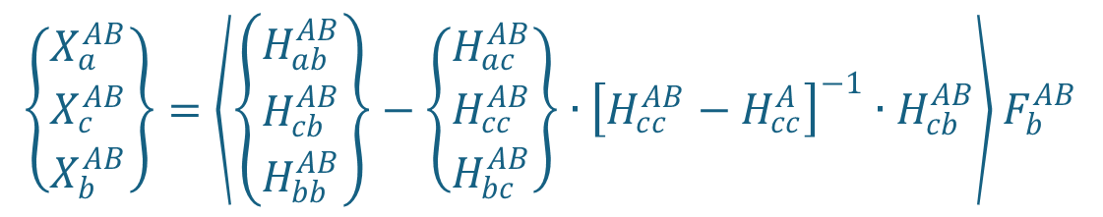
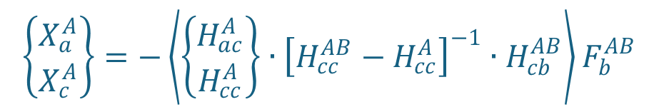
Frequency based decoupling
$$X^{(AB)}=\left[H^{(AB)}−{{H^{(AB)}B}^{(AB)}}^{T}{\left[B^{(AB)}H^{(AB)}{B^{(AB)}}^{T}−B^{(A)}H^{(A)}{B^{(A)}}^{T}\right]}^{−1} B^{(AB)}H^{(AB)}\right]F^{(AB)}$$
$$\left\{\begin{matrix}X_{a}^{AB} \\ X_{c}^{AB} \\ X_{b}^{AB}\end{matrix}\right\}=\left\langle \left[\begin{matrix}H_{aa}^{AB} & H_{ac}^{AB} & H_{ab}^{AB} \\ H_{ca}^{AB} & H_{cc}^{AB} & H_{cb}^{AB} \\ H_{ba}^{AB} & H_{bc}^{AB} & H_{bb}^{AB}\end{matrix}\right]−\left[\begin{matrix}H_{aa}^{AB} & H_{ac}^{AB} & H_{ab}^{AB} \\ H_{ca}^{AB} & H_{cc}^{AB} & H_{cb}^{AB} \\ H_{ba}^{AB} & H_{bc}^{AB} & H_{bb}^{AB}\end{matrix}\right]\left\{\begin{matrix}0 \\ I \\ 0\end{matrix}\right\}∙{\left[\left\{\begin{matrix}0 & I & 0\end{matrix}\right\}\left[\begin{matrix}H_{aa}^{AB} & H_{ac}^{AB} & H_{ab}^{AB} \\ H_{ca}^{AB} & H_{cc}^{AB} & H_{cb}^{AB} \\ H_{ba}^{AB} & H_{bc}^{AB} & H_{bb}^{AB}\end{matrix}\right]\left\{\begin{matrix}0 \\ I \\ 0\end{matrix}\right\}−\left\{\begin{matrix}0 & −I\end{matrix}\right\}\left[\begin{matrix}H_{aa}^{A} & H_{ac}^{A} \\ H_{ca}^{A} & H_{cc}^{A}\end{matrix}\right]\left\{\begin{matrix}0 \\ −I\end{matrix}\right\}\right]}^{−1}∙\left\{\begin{matrix}0 & I & 0\end{matrix}\right\}\left[\begin{matrix}H_{aa}^{AB} & H_{ac}^{AB} & H_{ab}^{AB} \\ H_{ca}^{AB} & H_{cc}^{AB} & H_{cb}^{AB} \\ H_{ba}^{AB} & H_{bc}^{AB} & H_{bb}^{AB}\end{matrix}\right]\right\rangle \left\{\begin{matrix}0 \\ 0 \\ F_{b}^{AB}\end{matrix}\right\}$$
$$\left\{\begin{matrix}X_{a}^{AB} \\ X_{c}^{AB} \\ X_{b}^{AB}\end{matrix}\right\}=\left\langle \left\{\begin{matrix}H_{ab}^{AB} \\ H_{cb}^{AB} \\ H_{bb}^{AB}\end{matrix}\right\}−\left\{\begin{matrix}H_{ac}^{AB} \\ H_{cc}^{AB} \\ H_{bc}^{AB}\end{matrix}\right\}∙{\left[H_{cc}^{AB}−H_{cc}^{A}\right]}^{−1}∙H_{cb}^{AB}\right\rangle F_{b}^{AB}$$
$$X^{(A)}=\left[H^{(A)}{B^{(A)}}^{T}{\left[B^{(AB)}H^{(AB)}{B^{(AB)}}^{T}−B^{(A)}H^{(A)}{B^{(A)}}^{T}\right]}^{−1} B^{(AB)}H^{(AB)}\right]F^{(AB)}$$
$$\left\{\begin{matrix}X_{a}^{A} \\ X_{c}^{A}\end{matrix}\right\}=\left\langle \left[\begin{matrix}H_{aa}^{A} & H_{ac}^{A} \\ H_{ca}^{A} & H_{cc}^{A}\end{matrix}\right]\left\{\begin{matrix}0 \\ −I\end{matrix}\right\}∙{\left[\left\{\begin{matrix}0 & I & 0\end{matrix}\right\}\left[\begin{matrix}H_{aa}^{AB} & H_{ac}^{AB} & H_{ab}^{AB} \\ H_{ca}^{AB} & H_{cc}^{AB} & H_{cb}^{AB} \\ H_{ba}^{AB} & H_{bc}^{AB} & H_{bb}^{AB}\end{matrix}\right]\left\{\begin{matrix}0 \\ I \\ 0\end{matrix}\right\}−\left\{\begin{matrix}0 & −I\end{matrix}\right\}\left[\begin{matrix}H_{aa}^{A} & H_{ac}^{A} \\ H_{ca}^{A} & H_{cc}^{A}\end{matrix}\right]\left\{\begin{matrix}0 \\ −I\end{matrix}\right\}\right]}^{−1}∙\left\{\begin{matrix}0 & I & 0\end{matrix}\right\}\left[\begin{matrix}H_{aa}^{AB} & H_{ac}^{AB} & H_{ab}^{AB} \\ H_{ca}^{AB} & H_{cc}^{AB} & H_{cb}^{AB} \\ H_{ba}^{AB} & H_{bc}^{AB} & H_{bb}^{AB}\end{matrix}\right]\right\rangle \left\{\begin{matrix}0 \\ 0 \\ F_{b}^{AB}\end{matrix}\right\}$$
$$\left\{\begin{matrix}X_{a}^{A} \\ X_{c}^{A}\end{matrix}\right\}=−\left\langle \left\{\begin{matrix}H_{ac}^{A} \\ H_{cc}^{A}\end{matrix}\right\}∙{\left[H_{cc}^{AB}−H_{cc}^{A}\right]}^{−1}∙H_{cb}^{AB}\right\rangle F_{b}^{AB}$$

Slide 11
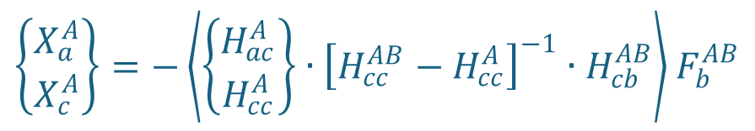
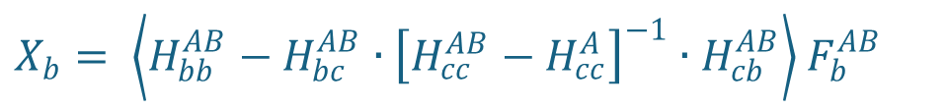
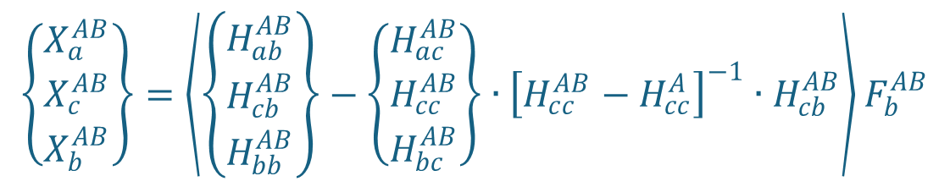
Frequency based decoupling
$$X_{a}^{(AB)}$$
$$X_{c}^{(AB)}$$
$$X_{b}^{(AB)}$$
$$X_{a}^{(A)}$$
$$X_{c}^{(A)}$$
$$X_{c}^{(B)}$$
$$X_{b}^{(B)}$$
AB
-A
B
$$\left\{\begin{matrix}X_{a}^{AB} \\ X_{c}^{AB} \\ X_{b}^{AB}\end{matrix}\right\}=\left\langle \left\{\begin{matrix}H_{ab}^{AB} \\ H_{cb}^{AB} \\ H_{bb}^{AB}\end{matrix}\right\}−\left\{\begin{matrix}H_{ac}^{AB} \\ H_{cc}^{AB} \\ H_{bc}^{AB}\end{matrix}\right\}∙{\left[H_{cc}^{AB}−H_{cc}^{A}\right]}^{−1}∙H_{cb}^{AB}\right\rangle F_{b}^{AB}$$
Identical since a in AB
is equal to a in -A
Identical by construction
$$\left\{\begin{matrix}X_{a}^{A} \\ X_{c}^{A}\end{matrix}\right\}=−\left\langle \left\{\begin{matrix}H_{ac}^{A} \\ H_{cc}^{A}\end{matrix}\right\}∙{\left[H_{cc}^{AB}−H_{cc}^{A}\right]}^{−1}∙H_{cb}^{AB}\right\rangle F_{b}^{AB}$$
$X_{b}= \left\langle H_{bb}^{AB}−H_{bc}^{AB}∙{\left[H_{cc}^{AB}−H_{cc}^{A}\right]}^{−1}∙H_{cb}^{AB}\right\rangle$ $F_{b}^{AB}$

Slide 12
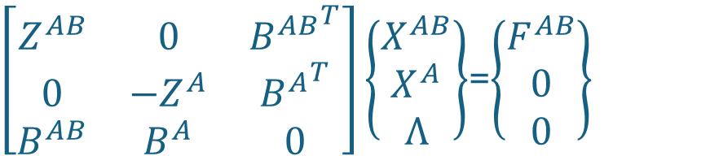
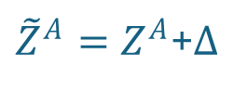
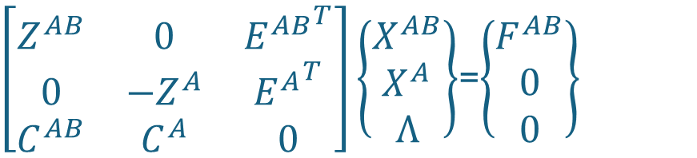
Frequency based decoupling
Let us reconsider
$$X_{a}^{(AB)}$$
$$X_{c}^{(AB)}$$
$$X_{b}^{(AB)}$$
$$X_{a}^{(A)}$$
$$X_{c}^{(A)}$$
$$X_{c}^{(B)}$$
$$X_{b}^{(B)}$$
AB
-A
B
$\left[\begin{matrix}Z^{AB} & 0 & {B^{AB}}^{T} \\ 0 & {−Z}^{A} & {B^{A}}^{T} \\ B^{AB} & B^{A} & 0\end{matrix}\right]\left\{\begin{matrix}X^{AB} \\ X^{A} \\ Λ\end{matrix}\right\}$=$\left\{\begin{matrix}F^{AB} \\ 0 \\ 0\end{matrix}\right\}$
AB is an assembly of A and B, but
A in AB can be different from A alone
due to measurement/modeling errors.
Hence,
${\tilde{Z}}^{A}=Z^{A}$+$∆$
$\left[\begin{matrix}Z^{AB} & 0 & {E^{AB}}^{T} \\ 0 & {−Z}^{A} & {E^{A}}^{T} \\ C^{AB} & C^{A} & 0\end{matrix}\right]\left\{\begin{matrix}X^{AB} \\ X^{A} \\ Λ\end{matrix}\right\}$=$\left\{\begin{matrix}F^{AB} \\ 0 \\ 0\end{matrix}\right\}$
If E=C, then the equilibrium and the compatibility are “collocated”
If not, they are “non-collocated”
Notes:
.

Slide 13
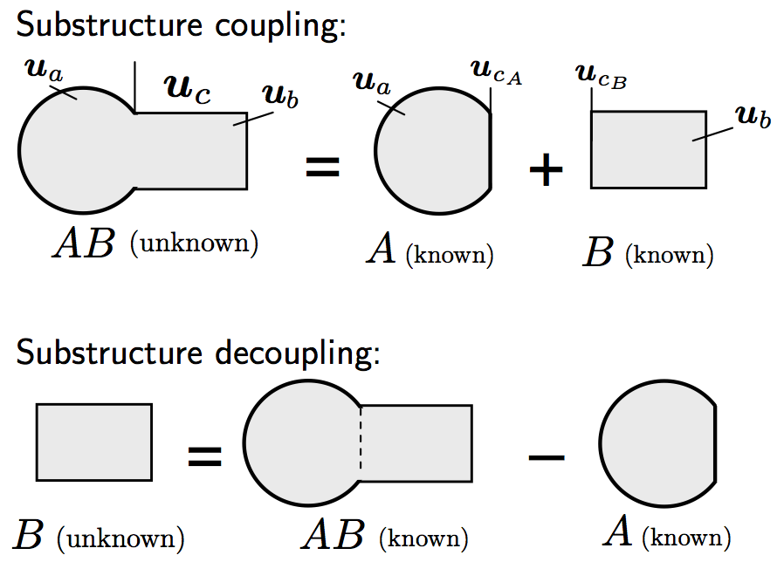




Frequency Based Decoupling: A Big Family
Method 1: standard decoupling (collocated on the interface)
a
a
c
b
+
c
=
c
b
A
B
- A
B
$\left[\begin{matrix}Z^{AB} & 0 & {E^{AB}}^{T} \\ 0 & {−\tilde{Z}}^{A} & {E^{A}}^{T} \\ C^{AB} & C^{A} & 0\end{matrix}\right]\left\{\begin{matrix}X^{AB} \\ X^{A} \\ Λ\end{matrix}\right\}$=$\left\{\begin{matrix}F^{AB} \\ 0 \\ 0\end{matrix}\right\}$
note: forces drawn only in
standalone A for simplicity
$$C^{AB}=E^{AB}=\left[\begin{matrix}0_{ca} & I_{cc} & 0_{cb}\end{matrix}\right]$$
corresponds to the method derived in the previous slides:
simple but very sensitive to errors !
$$C^{A}=E^{A}=\left[\begin{matrix}0_{ca} & {−I}_{cc}\end{matrix}\right]$$

Slide 14



Frequency Based Decoupling: A Big Family
Method 2: “extended interface” decoupling (collocated on interface and in A)
a
a
c
b
+
c
=
c
b
A
B
- A
B
$\left[\begin{matrix}Z^{AB} & 0 & {E^{AB}}^{T} \\ 0 & {−\tilde{Z}}^{A} & {E^{A}}^{T} \\ C^{AB} & C^{A} & 0\end{matrix}\right]\left\{\begin{matrix}X^{AB} \\ X^{A} \\ Λ\end{matrix}\right\}$=$\left\{\begin{matrix}F^{AB} \\ 0 \\ 0\end{matrix}\right\}$
$$C^{AB}=E^{AB}=\left[\begin{matrix}I_{aa} & 0_{ac} & 0_{ab} \\ 0_{ca} & I_{cc} & 0_{cb}\end{matrix}\right]$$
Request compatibility on interface and in some dofs of A
. uses more info of the problem
. still strong compatibility so sensitive to errors
. interface problem badly condition (could use SVD)
$$C^{A}=E^{A}=\left[\begin{matrix}{−I}_{aa} & 0_{ac} \\ 0_{ca} & {−I}_{cc}\end{matrix}\right]$$

Slide 15


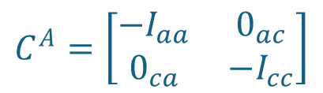
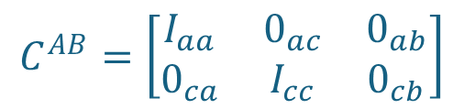
Frequency Based Decoupling: A Big Family
Method 3: Non-Collocated (NC) overdetermined forces on interface / compatibility on interface and in A
a
a
c
b
+
c
=
c
b
A
B
- A
B
$\left[\begin{matrix}Z^{AB} & 0 & {E^{AB}}^{T} \\ 0 & {−\tilde{Z}}^{A} & {E^{A}}^{T} \\ C^{AB} & C^{A} & 0\end{matrix}\right]\left\{\begin{matrix}X^{AB} \\ X^{A} \\ Λ\end{matrix}\right\}$=$\left\{\begin{matrix}F^{AB} \\ 0 \\ 0\end{matrix}\right\}$
$$E^{AB}=\left[\begin{matrix}0_{ca} & I_{cc} & 0_{cb}\end{matrix}\right]$$
$$E^{A}=\left[\begin{matrix}0_{ca} & {−I}_{cc}\end{matrix}\right]$$
$$C^{AB}=\left[\begin{matrix}I_{aa} & 0_{ac} & 0_{ab} \\ 0_{ca} & I_{cc} & 0_{cb}\end{matrix}\right]$$
More compatibility asked for than forces :
. uses more info of the problem
. only approximate (weak compatibility)
. interface problem overdetermined (least square)
$$C^{A}=\left[\begin{matrix}{−I}_{aa} & 0_{ac} \\ 0_{ca} & {−I}_{cc}\end{matrix}\right]$$

Slide 16

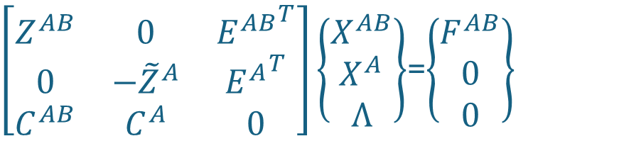



Frequency Based Decoupling: A Big Family
Method 4: Non-Collocated (NC) internal forces in A and compatibility on interface
a
a
c
b
+
c
=
c
b
A
B
- A
B
$\left[\begin{matrix}Z^{AB} & 0 & {E^{AB}}^{T} \\ 0 & {−\tilde{Z}}^{A} & {E^{A}}^{T} \\ C^{AB} & C^{A} & 0\end{matrix}\right]\left\{\begin{matrix}X^{AB} \\ X^{A} \\ Λ\end{matrix}\right\}$=$\left\{\begin{matrix}F^{AB} \\ 0 \\ 0\end{matrix}\right\}$
$$E^{AB}=\left[\begin{matrix}I_{aa} & 0_{ac} & 0_{ab}\end{matrix}\right]$$
$$E^{A}=\left[\begin{matrix}{−I}_{aa} & 0_{ac}\end{matrix}\right]$$
$$C^{AB}=\left[\begin{matrix}0_{ca} & I_{cc} & 0_{cb}\end{matrix}\right]$$
Works if the interface dofs are controllable from the dofs inside A
. no need to have driving points at interface (can be difficult to measure)
. approximate (weak) compatibility
. interface problem overdetermined if more c-dofs than a-dofs
$$C^{A}=\left[\begin{matrix}0_{ca} & {−I}_{cc}\end{matrix}\right]$$

Slide 17
Frequency Based Decoupling: A Big Family
Method 4: Non-Collocated (NC) internal forces in A and compatibility on interface
a
a
c
b
+
c
=
c
b
A
B
- A
B
Many other variants can be imagined by choosing other locations for the compatibility conditions and for the forces.
One could even imagine taking more forces than compatibility conditions. In that case the interface problem would be underdetermined, and a least square procedure would choose the force distribution with minimum norm.
This would correspond to a weakening on the force side.

Slide 18
Next Up: Nonlinear CMS

